Slide 1
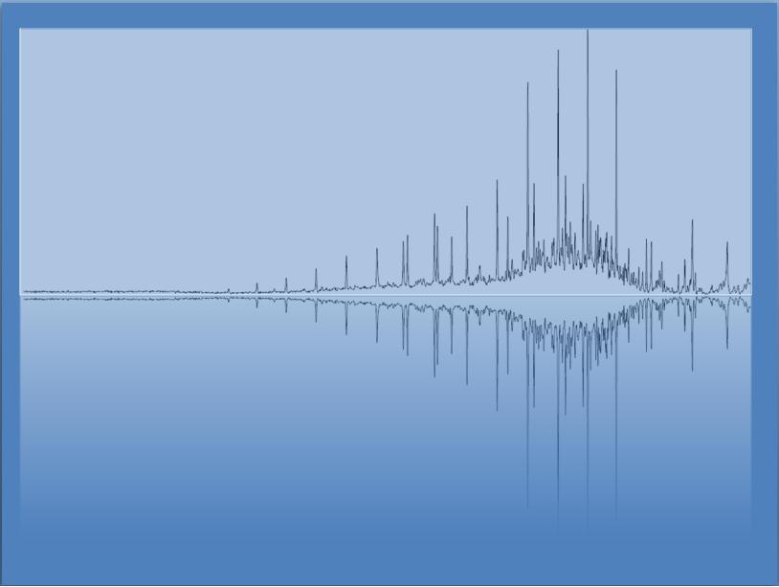
Acids & Bases
Chem 3A- Yates

Slide 2
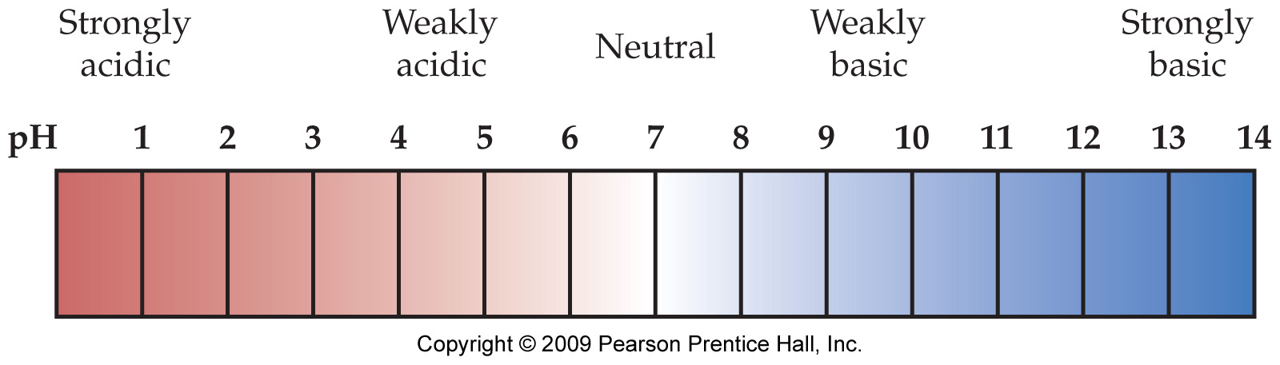
Things You Already Know -pH
Acids Bases
Taste Sour Taste Bitter
-Fruit Juice (i.e. citrus) -baking soda

Slide 3
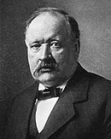
Early on when studying Chemistry…
Acids Bases
Have H⁺ Have OH⁻
-HCl, H₂SO₄ -NaOH
-HC₂H₃O₂ -Ca(OH)₂
…essentially a theory by
Svante Arrhenius
For which, he won the Nobel Prize in Chemistry in 1903

Slide 4
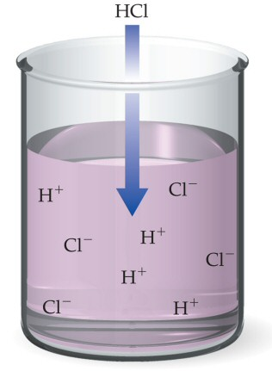
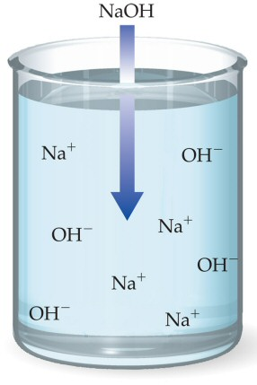
Arrhenius Theory
Bases dissociate in water to produce OH⁻ ions and cations.
NaOH(aq) → Na⁺(aq) + OH–(aq)
Acids ionize in water to produce H⁺ ions and anions.
HCl(aq) → H⁺(aq) + Cl–(aq)

Slide 5
Acids-Base theory is about water

Slide 6
Practical Measurements- with Anthocyanics in fruit and vegetable extracts
In Red Wine
Acidic Basic
(pinker) -----------------> (dark bluish-green)
In Swiss Chard

Slide 7
Quantifying Acid/Base Properties
Molarity of H⁺ ions in solution
1 M H⁺ 10-7 M H⁺ 10⁻¹⁴ M H⁺
pH = - log [H⁺]

Slide 8
Quantifying Acid/Base Properties
[H⁺] [OH⁻] = 10⁻¹⁴
pH = - log [H⁺]
pOH = - log [OH⁻]
[pH] [pOH] = 14

Slide 9
Problems with Arrhenius Theory
Does not explain why molecular substances, like NH₃, dissolve in water to form basic solutions—even though they do not contain OH– ions.
Does not explain acid–base reactions that do not take place in aqueous solution.
H⁺ ions do not exist in water. Acid solutions contain H₃O⁺ ions.
H₃O⁺ = hydronium ions.

Slide 10
Brønsted–Lowry Theory
A Brønsted-Lowry– transfer of H⁺. (*H⁺ is a proton)
Acid is H⁺ donor
Base is H⁺ acceptor.
HCl(aq) + H₂O(l) → Cl⁻(aq) + H₃O⁺(aq)
(acid) (base)
NH₃(aq) + H₂O(l) ⇔ NH₄⁺(aq) + OH⁻(aq)
(base) (acid)

Slide 11
Amphoteric Substances
Amphoteric substances can act as either an acid or a base.
Water acts as base, accepting H⁺.
HCl(aq) + H₂O(l) → Cl–(aq) + H₃O⁺(aq)
Water acts as acid, donating H⁺.
NH₃(aq) + H₂O(l) ⇔ NH₄⁺(aq) + OH–(aq)

Slide 12
Amphoteric Substances
Amphoteric substances can act as either an acid or a base.
Water acts as base, accepting H⁺.
HCl(aq) + H₂O(l) → Cl–(aq) + H₃O⁺(aq)
Water acts as acid, donating H⁺.
NH₃(aq) + H₂O(l) ⇔ NH₄⁺(aq) + OH–(aq)

Slide 13
Conjugate Pairs
The original base becomes the conjugate acid; the original acid becomes the conjugate base.
H₂SO₄ + H₂O ⇔ HSO₄– + H₃O⁺
Acid Base Conjugate Conjugate
base acid
HCO₃– + H₂O ⇔ H₂CO₃ + HO–
Base Acid Conjugate Conjugate
acid base

Slide 14
Practice—Write the Formula for the Conjugate Acid of the Following:
H₂O
NH₃
CO₃²⁻
H₂PO₄¹⁻

Slide 15
Practice—Write the Formula for the Conjugate Acid of the Following, Continued:
H₂O H₃O⁺
NH₃ NH₄⁺
CO₃²⁻ HCO₃⁻
H₂PO₄¹⁻ H₃PO₄

Slide 16
Practice—Write the Formula for the Conjugate Base of the Following:
H₂O
NH₃
CO₃²⁻
H₂PO₄¹⁻

Slide 17
Practice—Write the Formula for the Conjugate Base of the Following, Continued:
H₂O HO⁻
NH₃ NH₂⁻
CO₃²⁻ Since CO₃²⁻ does not have an H, it cannot be an acid.
H₂PO₄¹⁻ HPO₄²⁻

Slide 18
Practice—Write the Equations for the Following Reacting with Water and Acting as a Monoprotic Acid. Label the Conjugate Acid and Base.
HBr
HSO₄⁻¹

Slide 19
Practice—Write the Equations for the Following Reacting with Water and Acting as a Monoprotic Acid. Label the Conjugate Acid and Base, Continued.
HBr + H₂O → Br⁻¹ + H₃O⁺¹
Acid Base Conjugate Conjugate
base acid
HBr
HSO₄⁻¹
HSO₄⁻¹ + H₂O → SO₄⁻² + H₃O⁺¹
Acid Base Conjugate Conjugate
base acid

Slide 20
Practice—Write the Equations for the Following Reacting with Water and Acting as a Monoprotic-Accepting Base. Label the Conjugate Acid and Base.
I⁻
CO₃²⁻

Slide 21
Practice—Write the Equations for the Following Reacting with Water and Acting as a Monoprotic-Accepting Base. Label the Conjugate Acid and Base, Continued.
I⁻ + H₂O → HI + OH⁻
Base Acid Conjugate Conjugate
acid base
I⁻
CO₃²⁻
CO₃²⁻ + H₂O → HCO₃⁻ + OH⁻
Base Acid Conjugate Conjugate
acid base

Slide 22
Strong or Weak
A strong acid is a strong electrolyte.
Practically all the acid molecules ionize, →.
A strong base is a strong electrolyte.
Practically all the base molecules form OH– ions, either through dissociation or reaction with water, →.
A weak acid is a weak electrolyte.
Only a small percentage of the molecules ionize, ⇔.
A weak base is a weak electrolyte.
Only a small percentage of the base molecules form OH– ions, either through dissociation or reaction with water, ⇔.

Slide 23
Strong Acids Weak Acids
Hydrochloric acid, HCl
Hydrobromic acid, HBr
Hydroiodic acid, HI
Nitric acid, HNO₃
Perchloric acid, HClO₄
Sulfuric acid, H₂SO₄
Hydrofluoric acid, HF
Acetic acid, HC₂H₃O₂
Formic acid, HCHO₂
Sulfurous acid, H₂SO₃
Carbonic acid, H₂CO₃
Phosphoric acid, H₃PO₄

Slide 24
Determine the [H₃O⁺] in the Following Solutions:
1.5 M HCl
Strong Acid
3.0 M HC₂H₃O₂
Weak Acid

Slide 25
Determine the [H₃O⁺] in the Following Solutions:
1.5 M HCl
Since HCl is a strong acid, [H₃O⁺] = [HCl] = 1.5 M.
3.0 M HC₂H₃O₂
Since HC₂H₃O₂ is a weak acid, [H₃O⁺] << [HC₂H₃O₂].
Therefore, [H₃O⁺] << 3.0 M.

Slide 26
Strong Bases (Soluble Hydroxides)
Lithium hydroxide, LiOH
Sodium hydroxide, NaOH
Potassium hydroxide, KOH
Calcium hydroxide, Ca(OH)₂
Strontium hydroxide, Sr(OH)₂
Barium hydroxide, Ca(OH)₂

Slide 27
Some Weak Bases
Ammonia:
NH₃(aq) + H₂O(l) ⇔ NH₄⁺(aq) + OH⁻(aq)
Pyridine:
C₅H₅N(aq) + H₂O(l) ⇔ C₅H₅NH⁺(aq) + OH⁻(aq)
Methyl amine:
CH₃NH₂(aq) + H₂O(l) ⇔ CH₃NH₃⁺(aq) + OH⁻(aq)
Ethyl amine:
C₂H₅NH₂(aq) + H₂O(l) ⇔ C₂H₅NH₃⁺(aq) + OH⁻(aq)
Bicarbonate:
HCO₃⁻(aq) + H₂O(l) ⇔ H₂CO₃ (aq) + OH⁻(aq)

Slide 28
Determine the [OH⁻] in the Following Solutions:
2.25 M KOH
0.35 M CH₃NH₂
0.025 M Sr(OH)₂

Slide 29
Determine the [OH⁻] in the Following Solutions:
2.25 M KOH
Since KOH is a strong base, [OH⁻] = [KOH] x 1 = 2.25 M.
0.35 M CH₃NH₂
Since CH₃NH₂ is a weak base, [OH⁻] << [CH₃NH₂].
Therefore, [OH⁻] << 0.35 M.
0.025 M Sr(OH)₂
Since Sr(OH)₂ is a strong base, [OH⁻] = [Sr(OH)₂] x 2 = 0.050 M.

Slide 30
Buffers
Buffers- Resist Changes in pH
They neutralizing added acid or base.
Buffers are made by mixing together a weak acid and its conjugate base.
Or weak base and its conjugate acid.

Slide 31
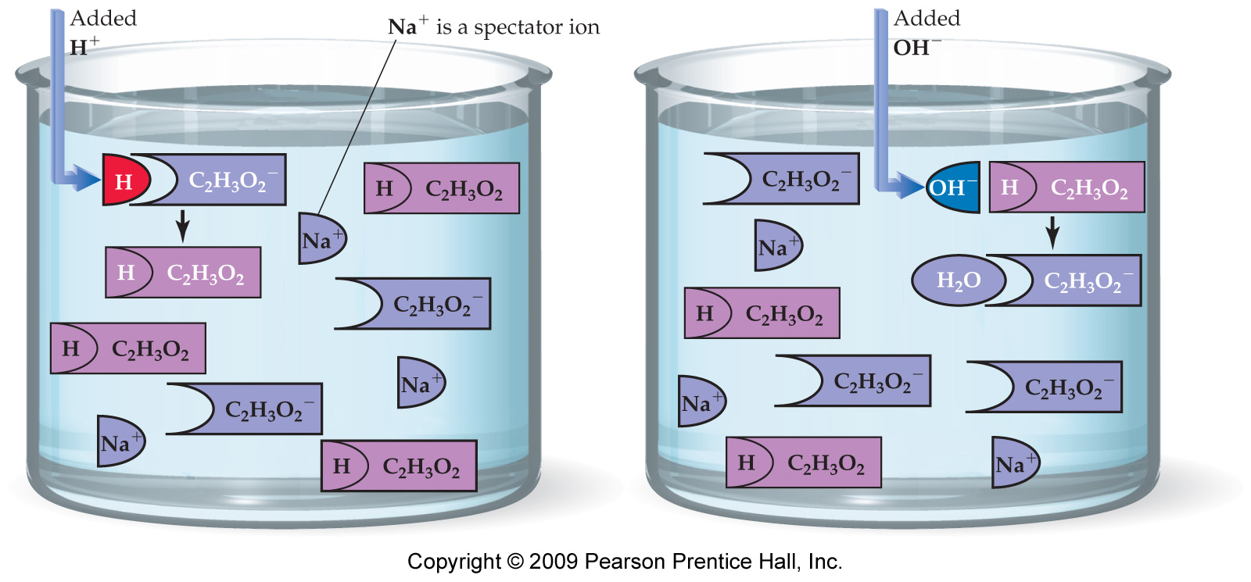
How Buffers Work
The weak acid present in the buffer mixture can neutralize added base.
The conjugate base present in the buffer mixture can neutralize added acid.

Slide 32
Autoionization of Water
About 1 out of every 10 million water molecules form ions through a process called autoionization.
H₂O ⇔ H⁺ + OH–
H₂O + H₂O ⇔ H₃O⁺ + OH–
All aqueous solutions contain both H₃O⁺ and OH–.
[H₃O⁺] = [OH–] = 1 x 10⁻⁷M at 25 °C in pure water.

Slide 33
Ion Product(K_{w}) of Water
The product of the H₃O⁺ and OH– concentrations is always the same number.
[H₃O⁺] x [OH–] = 1 x 10⁻¹⁴ = K_{w}.

Slide 34
Practice—Determine the [H₃O⁺] Concentration and Whether the Solution Is Acidic, Basic, or Neutral for the Following:
[OH–] = 0.000250 M
Ca(OH)₂ = 0.20 M

Slide 35
Practice—Determine the [H₃O⁺] Concentration and Whether the Solution Is Acidic, Basic, or Neutral for the Following, Continued:
[OH–] = 0.000250 M
Ca(OH)₂ = 0.20 M
1 x 10⁻¹⁴
2.50 x 10⁻⁴
[H₃O⁺] =
= 4.00 x 10⁻¹¹
[H₃O⁺] < [OH⁻¹], therefore, base.
[OH⁻¹] = 2 x 0.20 = 0.40 M
1 x 10⁻¹⁴
4.0 x 10⁻¹
[H₃O⁺] =
= 2.5 x 10⁻¹⁴
[H₃O⁺] < [OH⁻¹], therefore, base.

Slide 36
pH
pH = ─log[H₃O⁺]
pH < 7 is acidic; pH > 7 is basic; pH = 7 is neutral.

Slide 37
Example—Calculate the pH of a 0.0010 M Ba(OH)₂ Solution and Determine if It Is Acidic, Basic, or Neutral.

Slide 38
Example—Calculate the pH of a 0.0010 M Ba(OH)₂ Solution and Determine if It Is Acidic, Basic, or Neutral.
Ba(OH)₂ = Ba²⁺ + 2 OH⁻ therefore,
[OH⁻] = 2 x 0.0010 = 0.0020 = 2.0 x 10⁻³ M.
1 x 10⁻¹⁴
2.0 x 10⁻³
[H₃O⁺] =
= 5.0 x 10⁻¹²M
pH = −log [H₃O⁺] = −log (5.0 x 10⁻¹²)
pH = 11.3
pH > 7 therefore, basic.

Slide 39
Practice—Calculate the pH of the Following Strong Acid or Base Solutions.
0.0020 M HCl
0.0050 M Ca(OH)₂
0.25 M HNO₃

Slide 40
Practice—Calculate the pH of the Following Strong Acid or Base Solutions, Continued.
0.0020 M HCl therefore, [H₃O⁺] = 0.0020 M.
0.0050 M Ca(OH)₂ therefore, [OH–] = 0.010 M.
0.25 M HNO₃ therefore, [H₃O⁺] = 0.25 M.
pH = −log (2.0 x 10⁻³) = 2.70
1 x 10⁻¹⁴
1 x 10⁻²
[H₃O⁺] =
= 1.0 x 10⁻¹²
pH = −log (1.0 x 10⁻¹²) = 12.00
pH = −log (2.5 x 10⁻¹) = 0.60

Slide 41
Example—Calculate the Concentration of [H₃O⁺] for a Solution with pH 3.7.
[H₃O⁺] = 10^{-pH}
[H₃O⁺] = 10^{-3.7}
means 0.0001 < [H⁺¹] < 0.001.
[H₃O⁺] = 2 x 10⁻⁴ M = 0.0002 M.

Slide 42
Practice—Determine the [H₃O⁺] for Each of the Following:
pH = 2.7
pH = 12
pH = 0.60

Slide 43
Practice—Determine the [H₃O⁺] for Each of the Following, Continued:
pH = 2.7
pH = 12
pH = 0.60
[H₃O⁺] = 10^{−2.7} = 2 x 10⁻³ M = 0.002 M
[H₃O⁺] = 10⁻¹² = 1 x 10⁻¹² M
[H₃O⁺] = 10^{−0.60} = 0.25 M

Slide 44
pOH
pH = ─log[OH⁻]
pOH < 7 is acidic; pOH > 7 is basic, pOH = 7 is neutral.
pH + pOH = 14.00

Slide 45
Example—Calculate the pH of a 0.0010 M Ba(OH)₂ Solution and Determine if It Is Acidic, Basic, or Neutral.
Ba(OH)₂ = Ba⁺² + 2 OH⁻ therefore,
[OH⁻] = 2 x 0.0010 = 0.0020 = 2.0 x 10⁻³ M.
pOH = -log [OH⁻] = -log (2.0 x 10⁻³)
pOH = 2.70
pH = 14.00 - pOH = 14.00 - 2.70
pH = 11.30
pH > 7 therefore, basic.

Slide 46
Practice—Calculate the pOH and pH of the Following Strong Acid or Base Solutions.
0.0020 M KOH
0.0050 M Ca(OH)₂
0.25 M HNO₃

Slide 47
Practice—Calculate the pOH and pH of the Following Strong Acid or Base Solutions, Continued.
0.0020 M KOH therefore, [OH–] = 0.0020 M.
0.0050 M Ca(OH)₂ therefore, [OH–] = 0.010 M.
0.25 M HNO₃ therefore, [H₃O⁺] = 0.25 M.
pOH = −log (2.0 x 10⁻³) = 2.70
pH = 14.00 – 2.70 = 11.30
pOH = −log (1.0 x 10⁻²) = 2.00
pH = 14.00 – 2.00 = 12.00
pH = −log (2.5 x 10⁻¹) = 0.60
pOH = 14.00 – 0.60 = 13.40

